Slide 1
Google Cloud Architecture

Slide 2
Videos
Required: Google Cloud Platform Essentials (6 minutes)
https://www.youtube.com/watch?v=4D3X6Xl5c_Y
Optional: Google Cloud Platform 101 (45 minutes)
https://youtu.be/vmOMataJZWw

Slide 3
Grace Hopper (US, UK, ES) 2022
Havfrue (US, IE, DK) 2019
Dunant (US, FR) 2020
Faster (US, JP, TW) 2016
Equiano (PT, NG, ZA) 2021
PLCN (US, TW) 2020
SJC (JP, HK, SG) 2013
Unity (US, JP) 2010
Curie (CL, US) 2019
Monet
(US, BR)
2017
Junior (Rio, Santos) 2018
JGA-S (GU, AU) 2019
Tannat (BR, UY, AR) 2018
Indigo (SG, ID, AU) 2019
Google Cloud PoPs and Network
Edge point of presence
Network
Copyright Google LLC. For educational purposes in accordance with the terms of use set forth on the program Website.
Notes:
Google’s data centers around the world are interconnected by the Google network, which, by some publicly available estimates, carries as much as 40% of the world’s internet traffic every day. This is the largest network of its kind on Earth, and it continues to grow.
It’s designed to provide the highest possible throughput and the lowest possible latencies for applications.
The network interconnects with the public internet at more than 90 internet exchanges and more than 110 points of presence worldwide. When an internet user sends traffic to a Google resource, Google responds to the user's request from an Edge Network location that will provide the lowest delay or latency. Google’s edge caching network places content close to end users to minimize latency. Applications in Google Cloud can take advantage of this edge network too.

Slide 4



Google Cloud provides resources in multi-regions, regions, and zones
Deploying applications across multiple zones enables fault tolerance and high availability.
Multi-Region
Region
Zone
europe-west2-a
europe-west2-b
europe-west2-c
US
Europe
europe-west2
Copyright Google LLC. For educational purposes in accordance with the terms of use set forth on the program Website.
Notes:
Google Cloud divides the world into three multi-regional areas: the Americas, Europe, and Asia Pacific.
Next, the three multi-regional areas are divided into regions, which are independent geographic areas on the same continent. Within a region, there’s fast network connectivity: generally round-trip network latencies of under 1 millisecond (that is, at the 95th percentile).
Finally, regions are divided into zones, which are deployment areas for Google Cloud resources within a focused geographic area. You can think of a zone as a data center within a region, although strictly speaking a zone isn’t necessarily a single data center.
Compute Engine virtual-machine instances reside within a specific zone. If that zone became unavailable, so would your virtual machine and the workload running on it.
Deploying applications across multiple zones enables fault tolerance and high availability.

Slide 5
Finland
Netherlands
London
Warsaw
Montréal
Belgium
Frankfurt
Toronto
Paris
Oregon
Iowa*
Zurich
Milan
Salt Lake City
N. Virginia
Madrid
Las Vegas
Seoul
Tokyo
Los Angeles
S. Carolina
Osaka
Doha
Delhi
Taiwan
Mumbai
Hong Kong
Singapore
Jakarta
São Paulo
Santiago
Sydney
Melbourne
Current region with 3 zones
Future region with 3 zones
Google Cloud Regions and Zones
* Exception: region has 4 zones.
Google Cloud has expanded across 27 regions, 82 zones, 146 Network edge locations, and more than 200 countries and territories (https://cloud.google.com/about/locations/)
Copyright Google LLC. For educational purposes in accordance with the terms of use set forth on the program Website.
Notes:
Behind the services provided by Google Cloud lie a huge range of Google Cloud resources: physical assets, such as physical servers and hard disk drives; and virtual resources, such as virtual machines and containers. These resources are managed by Google within its global data centers. As of mid-2019, Google Cloud has expanded across 20 regions, 61 zones, and more than 200 countries and territories. This expansion will continue.

Slide 6
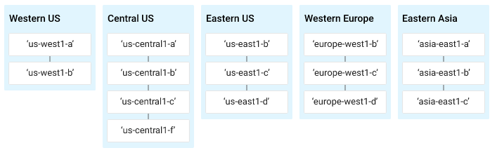
Understanding Regions and Zones
Certain Google Compute Engine resources live in regions or zones. A region is a specific geographical location where you can run your resources. Each region has one or more zones. For example, the us-central1 region denotes a region in the Central United States that has zones us-central1-a, us-central1-b, us-central1-c, and us-central1-f. The following image shows zones in their respective regions:

Slide 7
Resources that live in a zone are referred to as zonal resources.
Virtual machine instances and persistent disks live in a zone. If you want to attach a persistent disk to a virtual machine instance, both resources must be in the same zone.

Slide 8
GCP Services
Google Cloud’s products and services can be broadly categorized as
Compute,
Storage,
Big Data, and
Machine Learning.

Slide 9
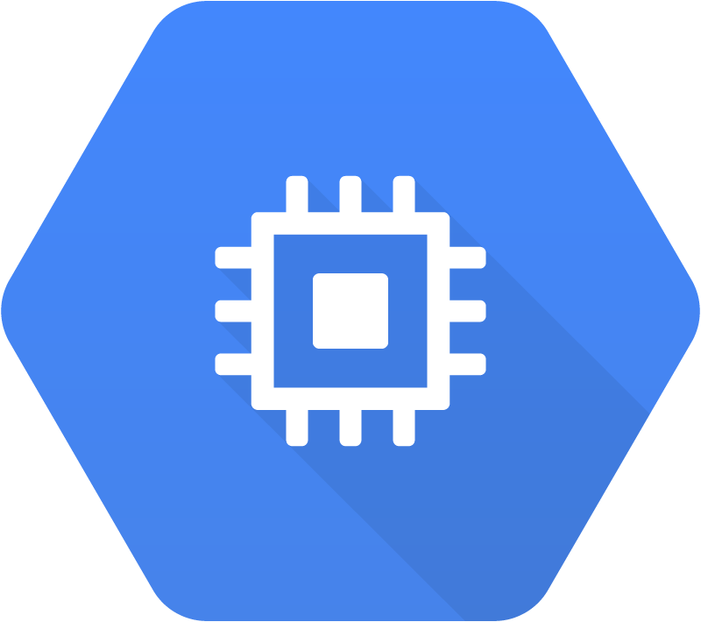
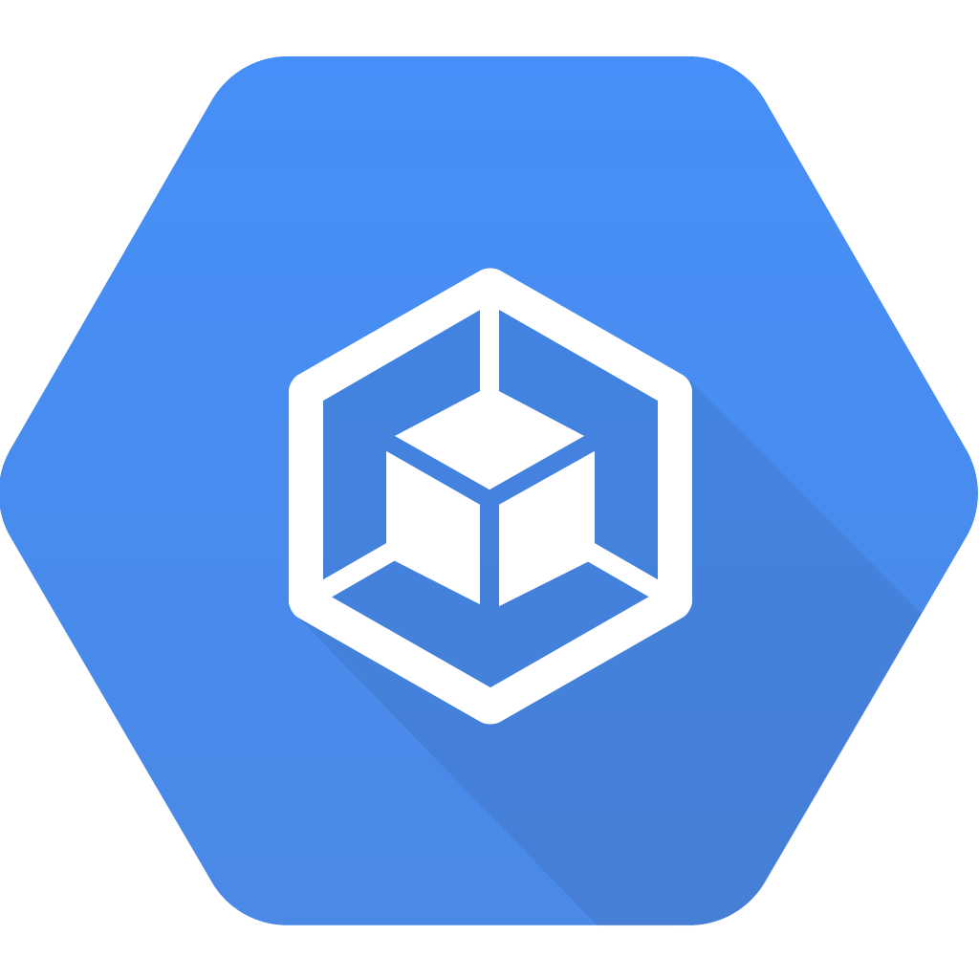
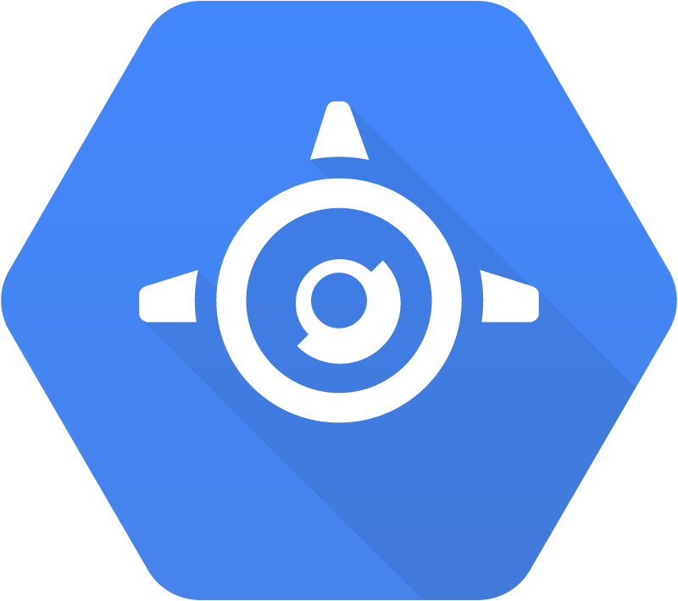
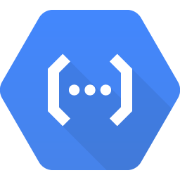
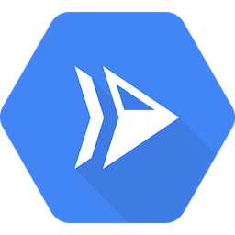
Google Cloud offers a range of compute services
Compute
Compute
Engine
Google Kubernetes Engine (GKE)
App Engine
Cloud
Functions
Cloud
Run
Copyright Google LLC. For educational purposes in accordance with the terms of use set forth on the program Website.
Notes:
Google Cloud’s products and services can be broadly categorized as Compute, Storage, Big Data, and Machine Learning. Leveraging compute can include virtual machines via Compute Engine, running Docker containers in a managed platform using Google Kubernetes Engine, deploying applications in a managed platform like App Engine, running event-based serverless code using Cloud Functions, or running stateless containers as a managed service like Cloud Run.

Slide 10
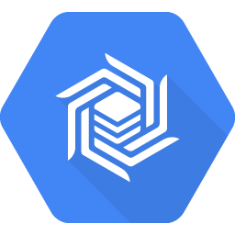
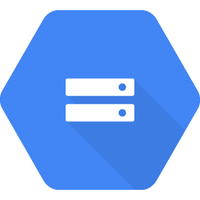
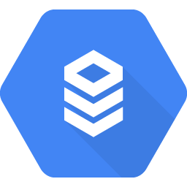
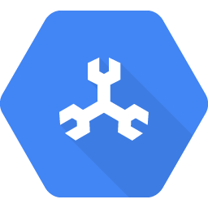
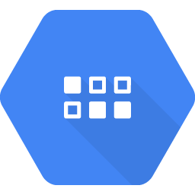
Google Cloud also offers a range of storage services
Storage
Cloud
Bigtable
Cloud
Storage
Cloud SQL
Cloud
Spanner
Datastore
Copyright Google LLC. For educational purposes in accordance with the terms of use set forth on the program Website.
Notes:
A variety of managed storage options are available as well. For unstructured storage there’s Cloud Storage, for managed relational databases there’s Cloud SQL or Cloud Spanner, and for NoSQL, there are options like Datastore or Cloud Bigtable.

Slide 11
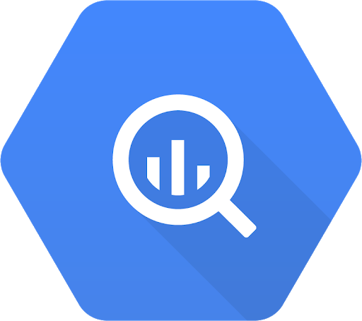
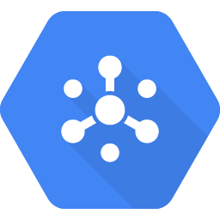
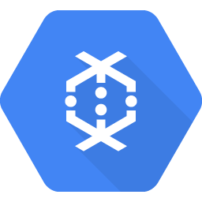
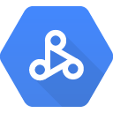
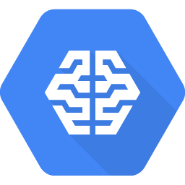
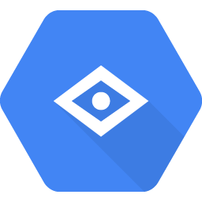

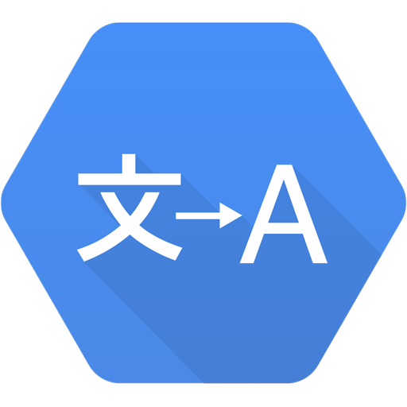
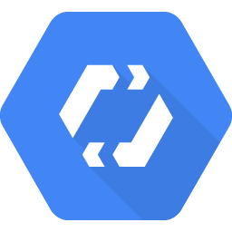
Google Cloud offers services to get value from data
Big data
BigQuery
Pub/Sub
Dataflow
Dataproc
AI Platform Notebooks
Machine learning
AI Platform
Vision API
Speech-to-Text API
Cloud Translation API
AutoML
Copyright Google LLC. For educational purposes in accordance with the terms of use set forth on the program Website.
Notes:
Managed services dealing with big data and machine learning are available as well.

Slide 12
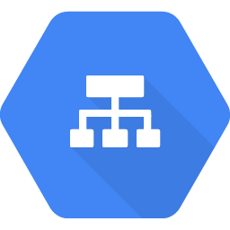
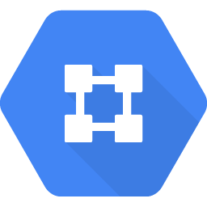
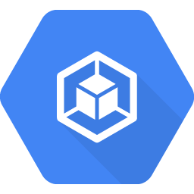
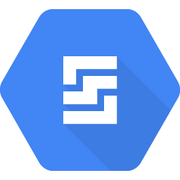
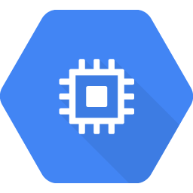
Resources are organized both physically and logically
Global
HTTP(S) load balancer
Virtual Private Cloud
Regional
Regional
Regional GKE cluster
Datastore
Zonal
Zonal
Persistent Disk
GKE
node
Compute Engine instance
Persistent
Disk
Physical organization
Copyright Google LLC. For educational purposes in accordance with the terms of use set forth on the program Website.
Notes:
When you take advantage of Google Cloud services and resources, you get to specify those resources’ geographical locations. In many cases you can also specify whether you’re doing so on a zonal level, a regional level, or a multi-regional level.
Zonal resources operate within a single zone, which means that if a zone becomes unavailable, the resources won’t be available either. A simple example would be a Compute Engine virtual machine instance and its persistent disks. GKE has a component called a “node,” and these are zonal too.
Regional resources operate across multiple zones, but within one region. An application using these resources can be redundantly deployed to improve its availability.
Finally, global resources can be managed across multiple regions. These resources can further improve the availability of an application. Some examples of such resources include HTTPS load balancers and Virtual Private Cloud networks.

Slide 13
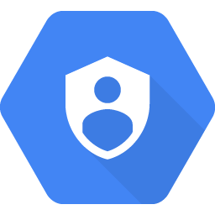
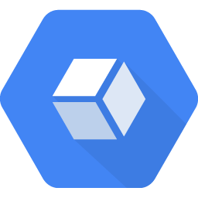
Resources are organized both physically and logically
Global
Project-1
HTTP(S) load balancer
Virtual Private Cloud
Regional
Regional
Regional GKE cluster
Datastore
Zonal
Zonal
Persistent Disk
GKE
node
Compute Engine instance
Persistent
Disk
Physical organization
Logical organization
Copyright Google LLC. For educational purposes in accordance with the terms of use set forth on the program Website.
Notes:
The Google Cloud resources you use, no matter where they reside, must belong to a project. So what is a project?
A project is the base-level organizing entity for creating and using resources and services and managing billing, APIs, and permissions. Zones and regions physically organize the Google Cloud resources you use, and projects logically organize them. Projects can be easily created, managed, deleted, or even recovered from accidental deletions.

Slide 14
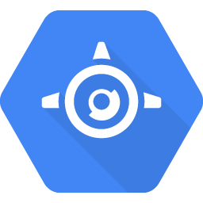
Resources have hierarchy
Organization
Organization
Folders
Team A
Team B
Product 1
Product 2
Projects
Store front
Test project
Production
Resources
GKE
Cloud Storage bucket
Compute Engine instance
App Engine service
Copyright Google LLC. For educational purposes in accordance with the terms of use set forth on the program Website.
Notes:
Each project is identified by a unique project ID and project number. You can name your project and apply labels for filtering. These labels are changeable, but the project ID and project number remain fixed.
Projects can belong to a “folder” which is another grouping mechanism.
You should use folders to reflect the hierarchy of your enterprise and apply policies at the right levels in your enterprise. You can nest folders inside folders. For example, you can have a folder for each department, and within each department’s folder, you can have subfolders for each of the teams that make it up. Each team’s projects belong to its folder.
A single organization owns the folders beneath it. An organization is the root node of a Google Cloud resource hierarchy. Although you are not required to have an organization to use Google Cloud, organizations are very useful. Organizations let you set policies that apply throughout your enterprise. Also, having an organization is required to use folders.
The Google Cloud resource hierarchy helps you manage resources across multiple departments and multiple teams within an organization.
You can define a hierarchy that creates trust boundaries and resource isolation. For example, should members of your Human Resources team be able to delete running database servers? And should your engineers be able to delete the database containing employees’ salaries? Probably not, in either case!
Cloud Identity and Access Management, also called Cloud IAM ***I-A-M*** , lets you fine-tune access control to all the Google Cloud resources you use. You define IAM policies that control user access to resources.

Slide 15
Start with a Solid Platform
Copyright Google LLC. For educational purposes in accordance with the terms of use set forth on the program Website.
Notes:
Hi, I’m ______.
Welcome to the module Start with a Solid Platform.

Slide 16
Course map
Module 1
Module 2
Module 3
Module 4
Module 5
So, What’s the Cloud Anyway?
Start with a Solid Platform
Use Google Cloud to Build Your Apps
Where Do I Store This Stuff?
There’s an API for That!
Module 6
Module 7
Module 8
Module 9
Module 10
You Can’t Secure the Cloud, Right?
It Helps to Network
Let Google Keep an Eye on Things
You Have the Data, but What Are You Doing with It?
Let Machines Do the Work
Google Cloud skills badges
Copyright Google LLC. For educational purposes in accordance with the terms of use set forth on the program Website.
Notes:
In the first module, we discussed what Cloud is and why it’s a technological and business game changer. Start with a Solid Platform is the second module of the Google Cloud Computing Foundations course, and will look at the different ways that you can interact with Google Cloud.

Slide 17
Agenda
The Cloud Console
Understanding Projects
Billing in Google Cloud
Install and Configure the Cloud SDK
Use Cloud Shell
Copyright Google LLC. For educational purposes in accordance with the terms of use set forth on the program Website.
Notes:
This module starts by exploring the Cloud Console followed by an introduction to projects and billing. The topics that follow address installing and configuring the Cloud SDK and how to use Cloud Shell as an alternative to the Cloud SDK. We’ll then complete our first lab, where we’ll take our first steps with Google Cloud by getting hands-on practice with the Cloud Console.

Slide 18
Agenda
The Cloud Console
Understanding Projects
Billing in Google Cloud
Install and Configure the Cloud SDK
Use Cloud Shell
Copyright Google LLC. For educational purposes in accordance with the terms of use set forth on the program Website.
Notes:
Let’s start with our first topic, the Cloud Console.

Slide 19


There are four ways to interact with Google Cloud
>_
Google Cloud Console
Web user interface
Cloud SDK and Cloud Shell
Command-line interface
REST-based
API
For custom applications
Cloud Console mobile app
For iOS and Android
Copyright Google LLC. For educational purposes in accordance with the terms of use set forth on the program Website.
Notes:
There are four ways you can interact with Google Cloud, and we’ll talk about each in turn: the Cloud Console, the Cloud SDK and Cloud Shell, APIs, and the Cloud Console mobile app.

Slide 20
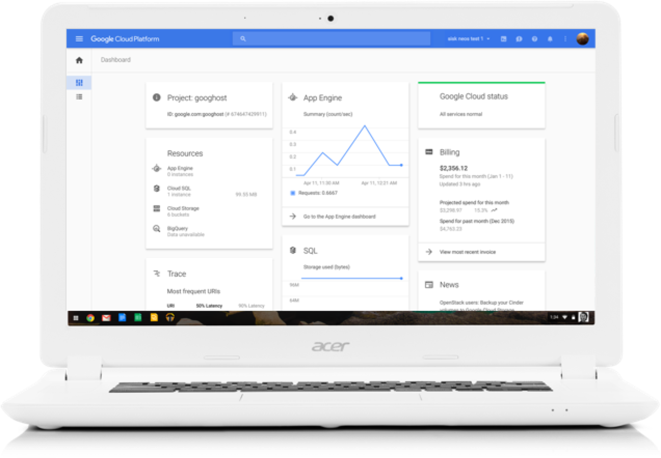
The Cloud Console provides a web-based GUI for you to manage Google Cloud projects and resources
Centralized console for all project data.
Execute common tasks using simple mouse clicks.
Manage and create projects.
Access developer tools:
Cloud Source Repositories
Cloud SDK
Cloud Shell
Access to product APIs.
Copyright Google LLC. For educational purposes in accordance with the terms of use set forth on the program Website.
Notes:
The Cloud Console serves as a centralized console for all of your project data, and lets you execute common tasks using simple mouse clicks with no need to remember commands or avoid typos.
When you use the Cloud Console, the resources that you create are done so in the context of a specific project. You can create multiple projects, so you can use projects to separate your work in whatever way makes sense for you. For example, you might start a new project if you want to make sure only certain team members can access the resources in that project, while all team members can continue to access resources in another project.
The Cloud Console is also great for developers. Cloud Source Repositories provides Git version control to support collaborative development of any application or service.
The Cloud SDK is a set of command-line tools for Google Cloud. You can run these tools interactively or in your automated scripts.
Cloud Shell also provides you with command-line access to your cloud resources directly from your browser, but without having to install the Cloud SDK or other tools on your system. The utilities you need are always available, up to date and fully authenticated when you need them.
The Cloud SDK and Cloud Shell will be discussed in more detail later in this module.
The Cloud SDK includes client libraries that enable you to easily create and manage resources. Google Cloud client libraries expose APIs for two main purposes. App APIs provide access to services and admin APIs offer functionality for resource management.

Slide 21
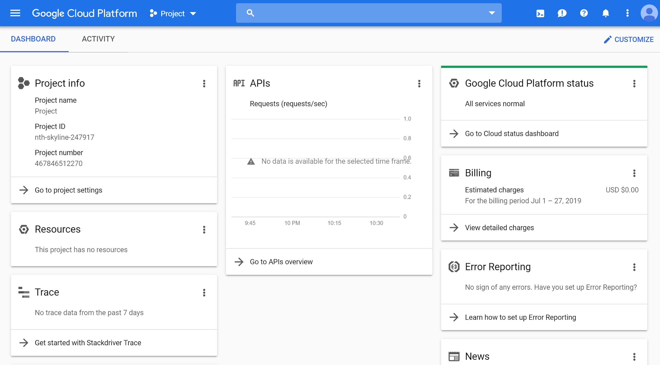
Logging in to the Cloud Console
Copyright Google LLC. For educational purposes in accordance with the terms of use set forth on the program Website.
Notes:
From a browser, go to console.cloud.google.com. If you haven’t already logged into your Google account, the system will prompt you to enter your credentials. After you log in, the Cloud Console will display the details of your default project.

Slide 22
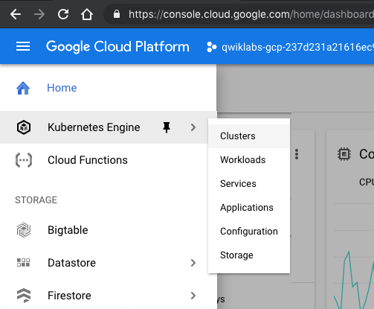
Interacting with the Cloud Console
Copyright Google LLC. For educational purposes in accordance with the terms of use set forth on the program Website.
Notes:
All Google Cloud services are accessible through the simple menu button in the top-left corner. You can pin frequently used services to this menu.

Slide 23
Agenda
The Cloud Console
Understanding Projects
Billing in Google Cloud
Install and Configure the Cloud SDK
Use Cloud Shell
Copyright Google LLC. For educational purposes in accordance with the terms of use set forth on the program Website.
Notes:
All Google Cloud resources that you allocate and use must belong to a Google Cloud project. You’ll learn more about projects in this topic.

Slide 24
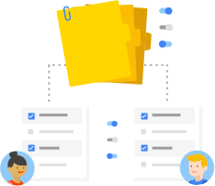
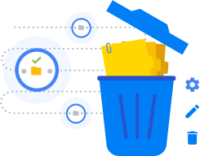
Every Google Cloud service you use is associated
with a project
Enable services and APIs.
Enable billing.
Manage permissions and credentials.
Track resource and quota usage.
Programmatically manage your projects in Google Cloud.
Copyright Google LLC. For educational purposes in accordance with the terms of use set forth on the program Website.
Notes:
Projects are the basis for enabling and using Google Cloud services, like managing APIs, enabling billing, adding and removing collaborators, and enabling other Google services. Each project is a separate account, and each resource belongs to exactly one. Projects can have different owners and users. They’re billed separately, and they’re managed separately.
Resource Manager provides ways for you to programmatically manage your projects in Google Cloud. You can access Resource Manager through an RPC API or REST API. With these APIs, you can get a list of all projects associated with an account, create new projects, update existing projects, and delete projects. You can also undelete, or recover, projects that you want to restore.

Slide 25
Projects have three identifying attributes
Project ID
Project name
Project number
Globally unique
Need not be unique
Globally unique
Assigned by Google Cloud but mutable during creation
Chosen by you
Assigned by Google Cloud
Immutable after creation
Mutable
Immutable
Copyright Google LLC. For educational purposes in accordance with the terms of use set forth on the program Website.
Notes:
Each Google Cloud project has a name and project ID that you assign. The project ID is a permanent, unchangeable identifier, and it has to be unique across Google Cloud. While a Project ID will be generated automatically, you can edit it. However, this must be done while creating the new project though as it cannot be modified afterwards. In general, project IDs are made to be human-readable strings, and you’ll use them frequently to refer to projects.
On the other hand, project names are for your convenience, and you can change them. Note though that you can’t reuse the project name of a deleted project.
Google Cloud also assigns each of your projects a unique project number, and you’ll see it displayed to you in various contexts, but using it is mostly outside the scope of this course.
As you work with Google Cloud, you'll use these identifiers in certain command lines and API calls.

Slide 26
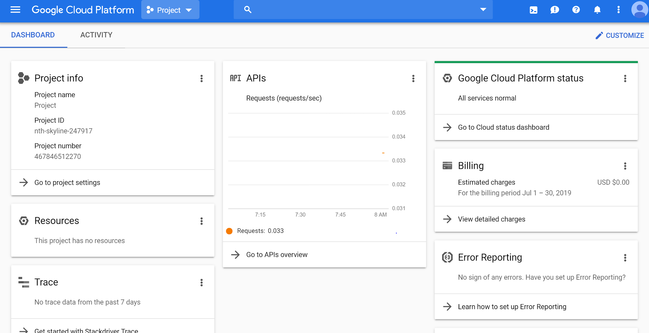
Creating a project
http://www.console.google.com
Copyright Google LLC. For educational purposes in accordance with the terms of use set forth on the program Website.
Notes:
To create a project, click on the name of the current project in the upper left portion of the screen.

Slide 27
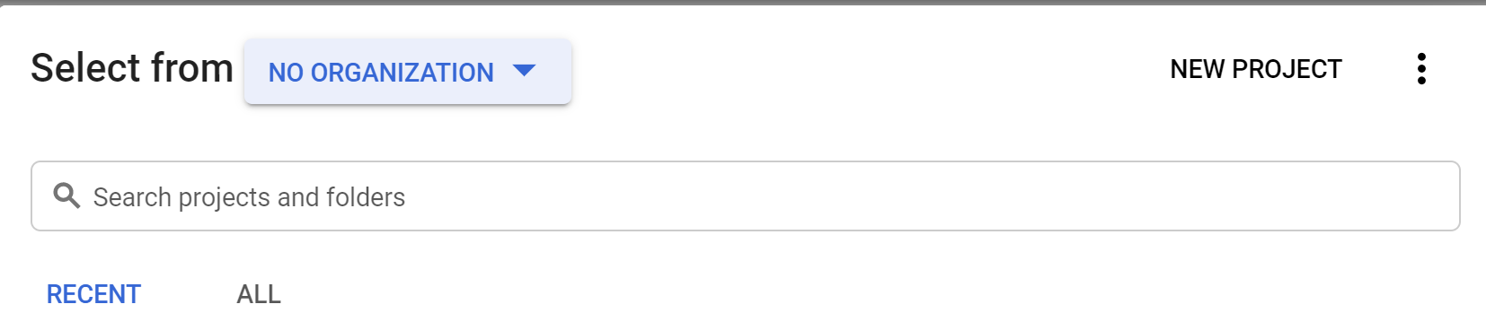
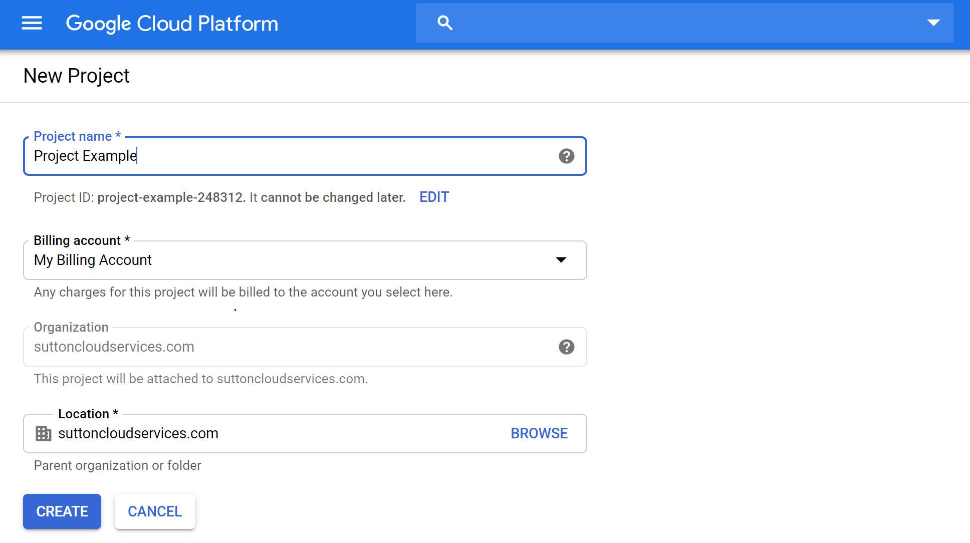
Creating a project
Copyright Google LLC. For educational purposes in accordance with the terms of use set forth on the program Website.
Notes:
A list of all current projects will be displayed. Select the New Project option on the right-hand side.
When the New Project screen is displayed, give your project a name. You have the option to use the auto-generated project ID, or create your own by clicking the Edit option. Project IDs must be globally unique. Select the appropriate billing account and organization and then click Create.

Slide 28
Agenda
The Cloud Console
Understanding Projects
Billing in Google Cloud
Install and Configure the Cloud SDK
Use Cloud Shell
Copyright Google LLC. For educational purposes in accordance with the terms of use set forth on the program Website.
Notes:
In the next topic, you’ll learn how billing works in Google Cloud.

Slide 29

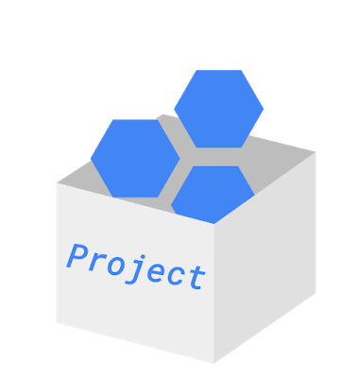
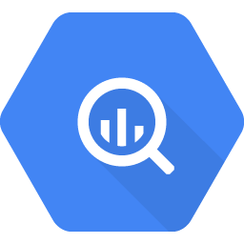
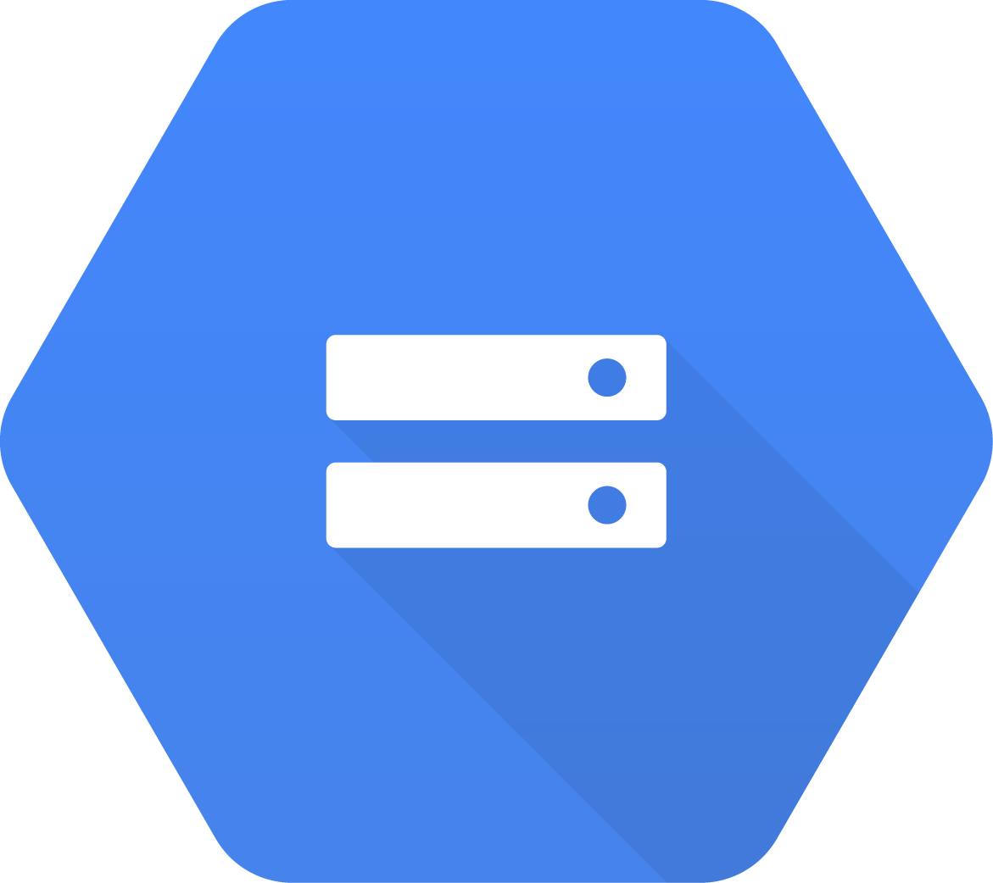
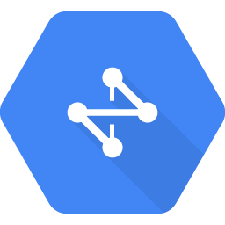
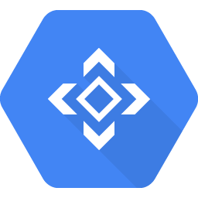
How billing works
Billing account pays for project resources.
A billing account is linked to zero or more projects.
Accounts are charged automatically, invoiced monthly, or invoiced at the threshold limit.
Sub accounts can be used for separate billing for projects.
BigQuery
Cloud Storage
VMs
Cloud Network
Cloud
APIs
Copyright Google LLC. For educational purposes in accordance with the terms of use set forth on the program Website.
Notes:
Billing in Google Cloud is set up at the Google Cloud project level. When you define a Google Cloud project, you link a billing account to it. This billing account is where you will configure all your billing information, including your payment option.
You can link your billing account to zero or more projects. Projects that you don’t link to any billing account can only use free Google Cloud services.
Your billing account can be charged automatically and invoiced every month, or at every threshold limit.
You can separate project billings by setting up billing subaccounts. Some Google Cloud customers who resell Google Cloud services use sub accounts for each of their own clients.

Slide 30
How to keep your billing under control
1
Budgets and alerts
2
Billing export
3
Reports
4
Quotas
Copyright Google LLC. For educational purposes in accordance with the terms of use set forth on the program Website.
Notes:
You’re probably thinking, “How can I make sure I don’t accidentally run up a big Google Cloud bill?” Google Cloud provides four tools to help:
Budgets and alerts,
Billing export,
Reports, and
Quotas.
We’ll discuss each of these in more detail next.

Slide 31
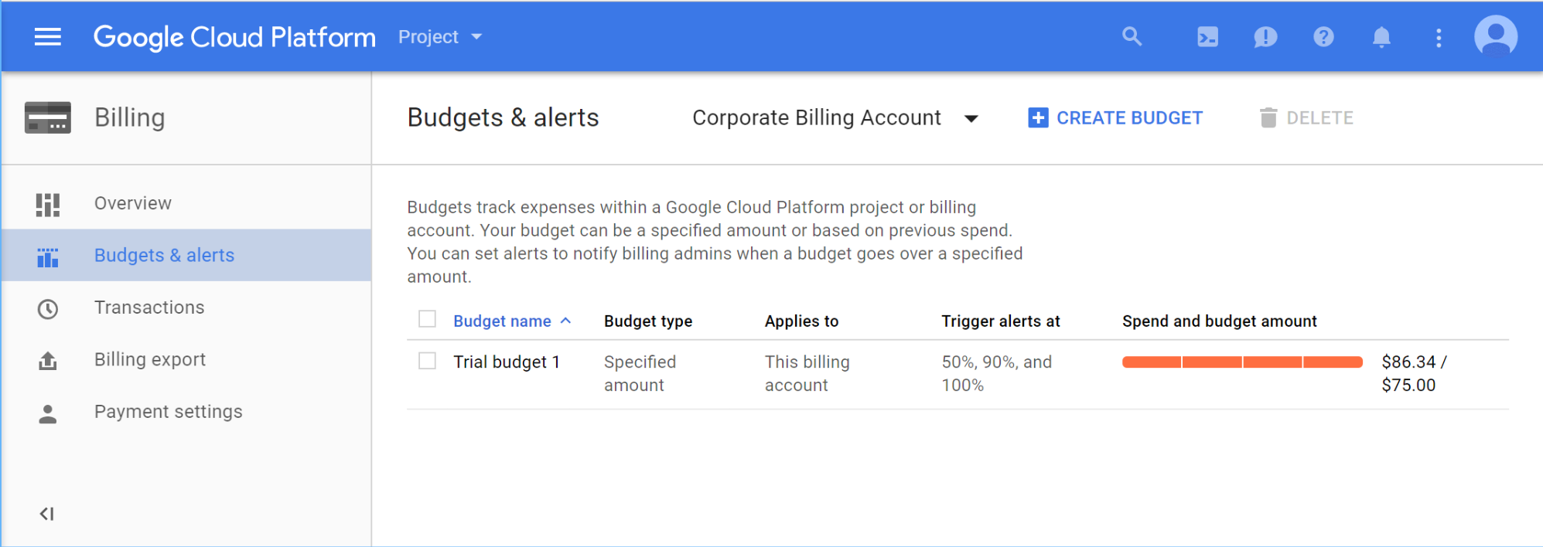
Budgets and alerts keep your billing under control
Copyright Google LLC. For educational purposes in accordance with the terms of use set forth on the program Website.
Notes:
You can define budgets at the billing account level or at the project level.
To be notified when costs approach your budget limit, you can create an alert. For example, with a budget limit of $20 and an alert set at 90%, you’ll receive a notification alert when your expenses reach $18.
You can also set up a webhook to be called in response to an alert. This webhook can control automation based on billing alerts. For example, you could trigger a script to shutdown resources when a billing alert occurs.

Slide 32
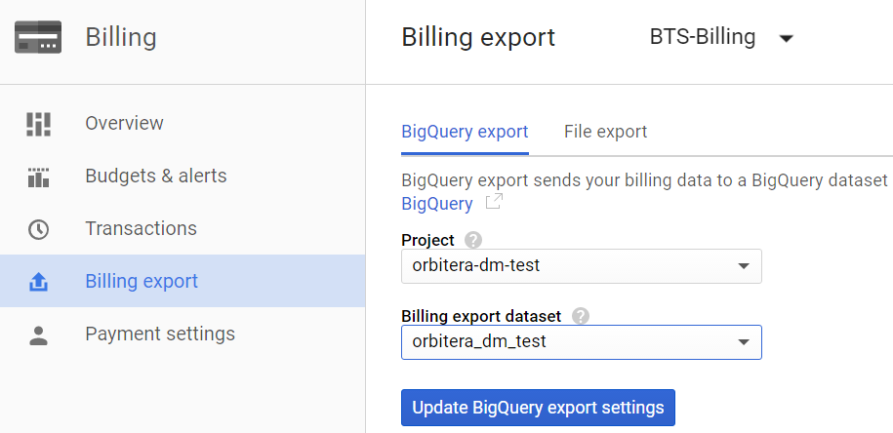
Billing export allows you to store detailed billing information
BigQuery
Cloud Storage
Copyright Google LLC. For educational purposes in accordance with the terms of use set forth on the program Website.
Notes:
Billing export allows you to store detailed billing information in places where it is easy to retrieve for external analysis, such as a BigQuery dataset or Cloud Storage bucket.

Slide 33
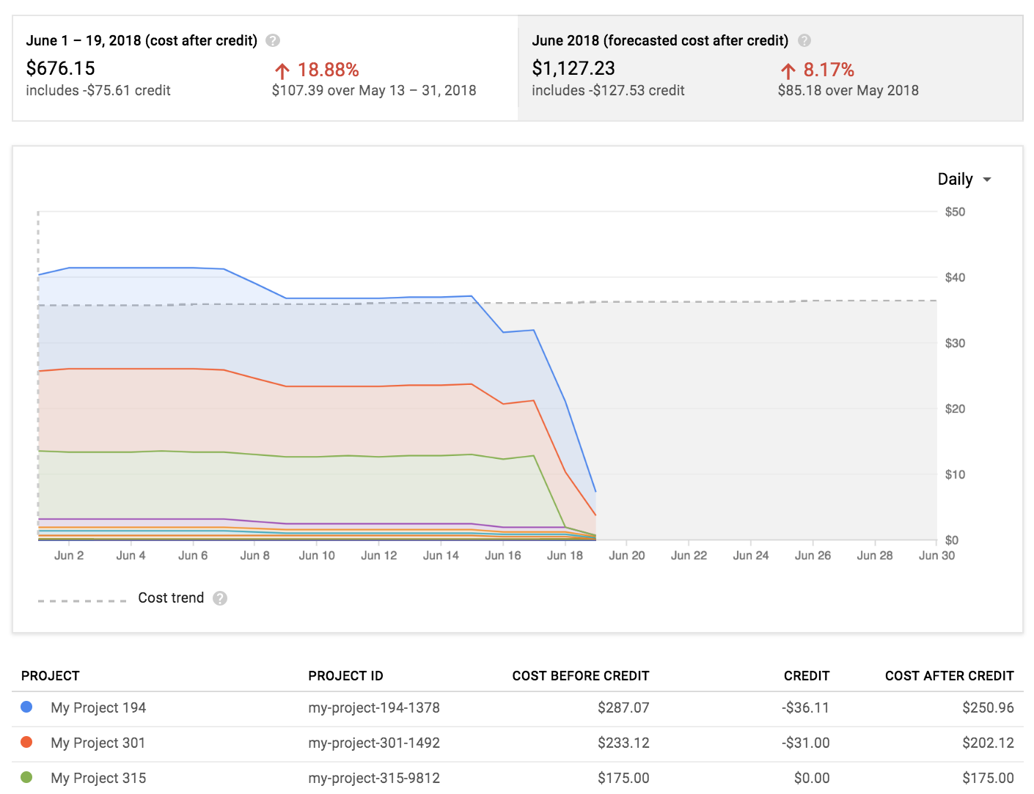
Reports is a visual tool to monitor expenditure
Copyright Google LLC. For educational purposes in accordance with the terms of use set forth on the program Website.
Notes:
And Reports is a visual tool in the Console that allows you to monitor expenditure based on a project or services.

Slide 34

Quotas are helpful limits
Rate quota
GKE API: 1,000 requests per 100 seconds
Allocation quota
5 networks per project
Many quotas are changeable
Copyright Google LLC. For educational purposes in accordance with the terms of use set forth on the program Website.
Notes:
Google Cloud also implements quotas, which limit unforeseen extra billing charges. Quotas are designed to prevent the over-consumption of resources because of an error or a malicious attack.
Quotas apply at the level of the Google Cloud project.
There are two types of quotas: rate quotas and allocation quotas. Rate quotas reset after a specific time. For example, by default, the Google Kubernetes Engine service implements a quota of 1,000 calls to its API from each Google Cloud project every 100 seconds.
Allocation quotas govern the number of resources you can have in your projects. For example, depending on the region, the number of GPUs permitted varies by type and region.
You can change quotas by requesting an increase from Google Cloud Support. You can also use the console to request a quota change.
Google Cloud quotas also protect the community of Google Cloud users by reducing the risk of unforeseen spikes in usage.

Slide 35
Agenda
The Cloud Console
Understanding Projects
Billing in Google Cloud
Install and Configure the Cloud SDK
Use Cloud Shell
Copyright Google LLC. For educational purposes in accordance with the terms of use set forth on the program Website.
Notes:
The Cloud Software Development Kit (SDK) enables a user to run Google Cloud command line tools from a local desktop. Installing and configuring the Cloud SDK is our next topic.

Slide 36
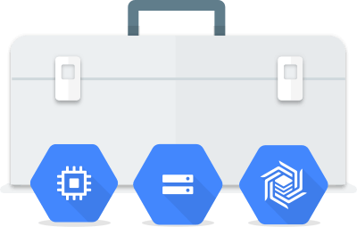
The Cloud SDK is a command-line interface for Google Cloud products and services
gcloud
gsutil
bq
Copyright Google LLC. For educational purposes in accordance with the terms of use set forth on the program Website.
Notes:
The Cloud SDK is a set of command-line tools that you can download and install onto a computer of your choice and use to manage resources and applications hosted on Google Cloud.
The gcloud ***gee cloud*** CLI manages authentication, local configuration, developer workflow, and interactions with Google Cloud APIs.
Gsutil ***gee ess util*** provides command line access to manage Cloud Storage buckets and objects.
bq *** bee cue*** allows you to run queries and manipulate datasets, tables, and entities in BigQuery through the command line.

Slide 37
Agenda
The Cloud Console
Understanding Projects
Billing in Google Cloud
Install and Configure the Cloud SDK
Use Cloud Shell
Copyright Google LLC. For educational purposes in accordance with the terms of use set forth on the program Website.
Notes:
Cloud Shell allows a user to run the Google command line without installing the Cloud SDK on a desktop. In this topic, we’ll learn how to utilize Cloud Shell.

Slide 38
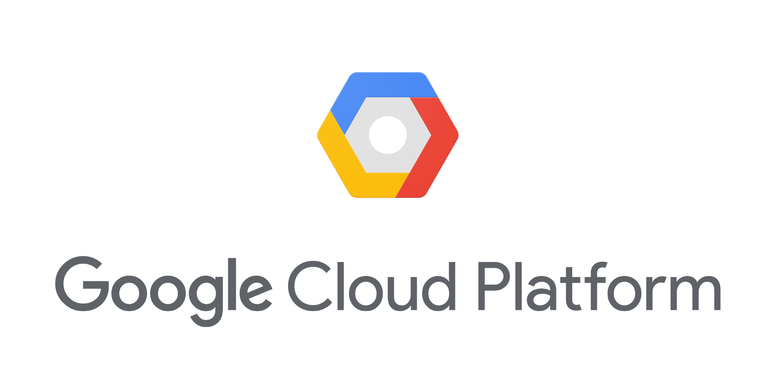
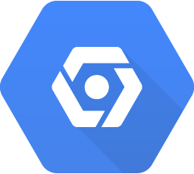
Cloud Shell is an alternative to the Cloud SDK
Cloud Console
console.cloud.google.com
Browser-based CLI access to resources
No need to install the Cloud SDK or other tools locally
Runs on an ephemeral Compute Engine VM at no cost to you
5 GB of persistent disk storage
Web preview functionality and built-in authorization for project/resource access
Cloud Shell
Cloud SDK
Copyright Google LLC. For educational purposes in accordance with the terms of use set forth on the program Website.
Notes:
Using Cloud Shell, you can manage your projects and resources easily without having to install the Cloud SDK or other tools locally. The Cloud SDK command-line tools and other utilities are always available, up to date, and fully authenticated.
Your Cloud Shell virtual machine is ephemeral, which means that it will be stopped whenever you stop using it interactively, and it’ll be restarted when you re-enter Cloud Shell. You get five gigabytes of persistent disk storage that is reattached for you every time a new Cloud Shell session is started.
Cloud Shell provides web preview functionality and built-in authorization for access to Cloud Console projects and resources.

Slide 39
Starting Cloud Shell
Copyright Google LLC. For educational purposes in accordance with the terms of use set forth on the program Website.
Notes:
To start Cloud Shell, click on the Activate Cloud Shell icon in the upper right side of the screen.

Slide 40
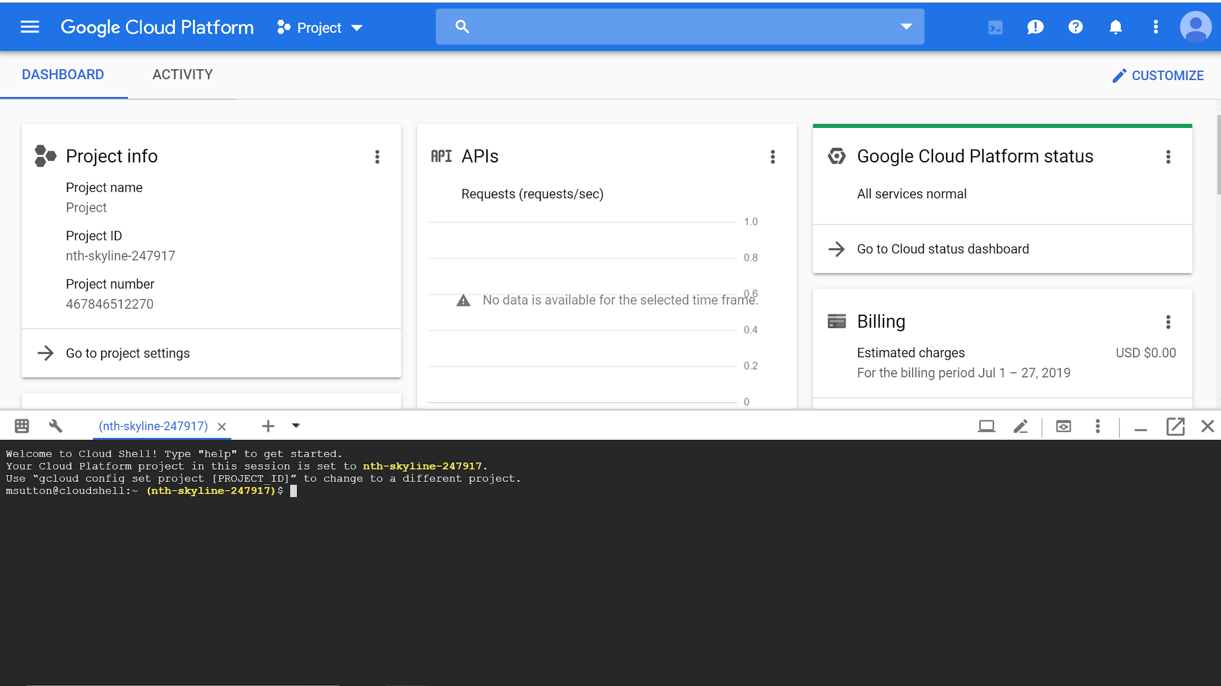
The Cloud Console and Cloud Shell
Copyright Google LLC. For educational purposes in accordance with the terms of use set forth on the program Website.
Notes:
The Cloud Shell terminal will appear on the lower portion of the window. Options, including launching the Cloud Shell code editor and opening Cloud Shell in a new page, can be performed using the tool bar on the upper right corner of Cloud Shell.

Slide 41
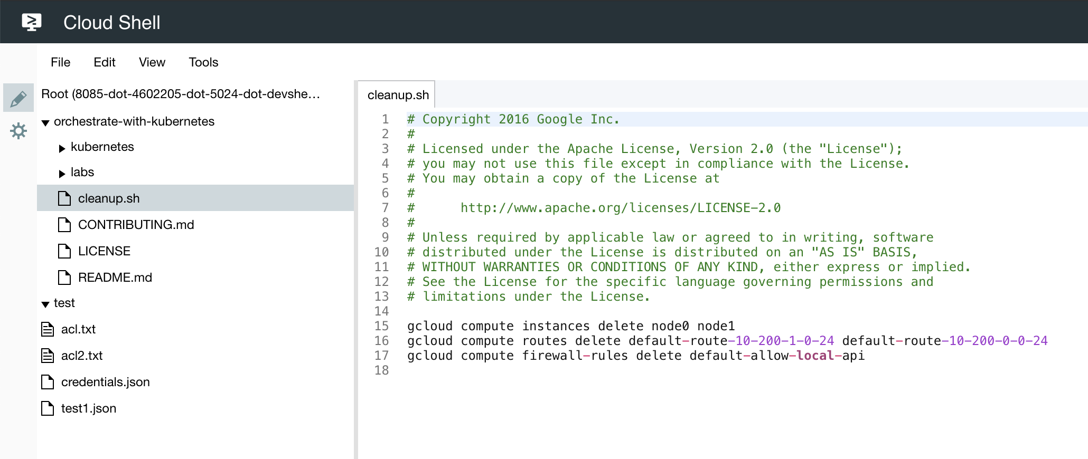
The Cloud Shell code editor is a tool for editing files inside your Cloud Shell environment
Copyright Google LLC. For educational purposes in accordance with the terms of use set forth on the program Website.
Notes:
The Cloud Shell code editor is a tool for editing files inside your Cloud Shell environment in real time within the web browser. This tool is extremely convenient when working with code-first applications or container-based workloads, because you can edit files easily without the need to download and upload changes. You can also use text editors from the Cloud Shell command prompt.

Slide 42
ICS432 Lab 1: Exercise 3
Qwiklab lab 1: A tour of Qwiklabs and Google cloud.
Learn about the Qwiklabs platform and identify key features of a lab environment.
Learn how to access the Cloud Console with specific credentials.

Slide 43
You Can’t Secure the Cloud, Right?
Copyright Google LLC. For educational purposes in accordance with the terms of use set forth on the program Website.
Notes:
Welcome to You Can’t Secure the Cloud, Right?.

Slide 44
Course map
Module 1
Module 2
Module 3
Module 4
Module 5
So, What’s the Cloud Anyway?
Start with a Solid Platform
Use Google Cloud to Build Your Apps
Where Do I Store This Stuff?
There’s an API for That!
Module 6
Module 7
Module 8
Module 9
Module 10
You Can’t Secure the Cloud, Right?
It Helps to Network
Let Google Keep an Eye on Things
You Have the Data, but What Are You Doing with It?
Let Machines Do the Work
Google Cloud skills badges
Copyright Google LLC. For educational purposes in accordance with the terms of use set forth on the program Website.
Notes:
We've reached module 6 in the Google Cloud Computing Foundations course. So far in this course we've learned about cloud computing and its importance, explored how to leverage Google Cloud to build applications, and examined storage options and APIs.
In this module, we'll learn about Google Cloud security best practices.

Slide 45

Learn how to ...
Outline how security in the cloud is administered in Google Cloud
Describe the shared security model in the cloud
Discuss Google’s security responsibility versus a customer’s responsibility
Explore the different encryption options with Google Cloud
Identify best practices when configuring authentication and authorization using Cloud Identity and Access Management (Cloud IAM)
Copyright Google LLC. For educational purposes in accordance with the terms of use set forth on the program Website.
Notes:
The objective of this module is for you to be able to outline how security in the cloud is administered in Google Cloud.
The specific learning objectives to achieve this include you being able to describe the shared security model in the cloud, discuss Google’s security responsibility versus a customer’s responsibility, and explore the different encryption options with Google Cloud. You’ll also be able to identify best practices when configuring authentication and authorization using Cloud IAM.

Slide 46
Agenda
Introduction to Security in the Cloud
The Shared Security Model
Encryption Options
Authentication and Authorization with Cloud IAM
Identify Best Practices for Authorization using Cloud IAM
Copyright Google LLC. For educational purposes in accordance with the terms of use set forth on the program Website.
Notes:
Let’s start with the first topic, an introduction to security in the cloud.

Slide 47
Video
Introduction to Cloud IAM (~5 mins video)
https://www.youtube.com/watch?v=96HlT4f2AUU&t=15s

Slide 48
Security empowers innovation
Google has operated securely in the cloud for +20 years!
7 services have +1 billion users a day.
Google connects to more than a billion IPs every day.
Copyright Google LLC. For educational purposes in accordance with the terms of use set forth on the program Website.
Notes:
Google believes that security empowers innovation and if you put security first, everything else will follow.
Google has been operating securely in the cloud for over 20 years and have 7 services each with over 1 billion users every day.
This means that Google and Google Cloud connect to more than a billion IPs every day. Designing for security is pervasive throughout our infrastructure, and security is always paramount.

Slide 49

Leverage Google’s technical infrastructure investment for your information processing lifecycle
Deployment of services
Storage of data
Communication between services
Operation by administrators
Copyright Google LLC. For educational purposes in accordance with the terms of use set forth on the program Website.
Notes:
Countless organizations have lost data due to security incidents. A single breach could cost millions in fines and lost business. More importantly, a serious data breach can permanently damage an organization's reputation with the loss of customer trust. As a result, security is increasingly top of mind for organizational leaders like CEOs and CISOs.
Unfortunately, many organizations don’t have access to the resources they need to implement state-of-the-art security controls and techniques. Google invests heavily in its technical infrastructure and has dedicated engineers tasked with providing a secure and robust platform.
By choosing Google Cloud, it’s possible to leverage that same infrastructure to help secure services and data through the entire information processing lifecycle including the deployment of services, the storage of data, communication between services, and operation by administrators.

Slide 50
Google’s infrastructure security layers
Operational security
Internet communication
Storage services
User identity
Service deployment
Hardware infrastructure
Copyright Google LLC. For educational purposes in accordance with the terms of use set forth on the program Website.
Notes:
Security cannot be an after-thought; it must be fundamental in all designs. That’s why Google builds security through progressive layers that deliver true defense in depth, meaning their cloud infrastructure doesn’t rely on any single technology to make it secure.

Slide 51
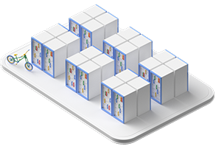
Securing the low level infrastructure
State-of-the-art data centers
Security of physical premises
Hardware design and provenance
Secure boot stack and machine identity
Copyright Google LLC. For educational purposes in accordance with the terms of use set forth on the program Website.
Notes:
Let’s start by talking about securing the low-level infrastructure.
Google designs and builds its own data centers, that incorporate multiple layers of physical security protections. For example, access to these data centers is limited to only a very small fraction of Google employees.
Google design their own servers, networking equipment, and hardware security chips in their data centers, and their servers use cryptographic signatures to make sure they are booting the correct software, at the correct version, in the correct data center.

Slide 52
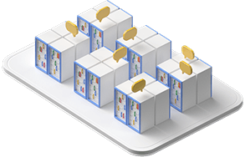
Securing service deployment
Service identity, integrity, and isolation and inter-service access management
Encryption of inter-service communication
External bug bounty program
Copyright Google LLC. For educational purposes in accordance with the terms of use set forth on the program Website.
Notes:
Now let's talk about a different layer in the stack - service deployments. Specifically we're talking about Google's service deployments the provide the fabric for Google Cloud.
When services communicate with one another, they do so via a remote procedure call (or "RPC"). If you're not familiar with RPC, that's okay, it's just a way to facilitate communication between services like REST over HTTP or XML over SOAP.
Google's infrastructure provides cryptographic privacy and integrity for all RPC calls for service-to-service communication.
In addition to their own security practices, Google also has an external bug bounty program in which third-party security researchers and developers can get monetary rewards for finding vulnerabilities in Google's software components.

Slide 53
Agenda
Introduction to Security in the Cloud
The Shared Security Model
Encryption Options
Authentication and Authorization with Cloud IAM
Identify Best Practices for Authorization using Cloud IAM
Copyright Google LLC. For educational purposes in accordance with the terms of use set forth on the program Website.
Notes:
Now that we have an overview of Google’s security model, we’ll learn about users’ security responsibilities in the cloud.

Slide 54
With Google Cloud, security responsibility is shared
Responsibility
On-
premises
IaaS
PaaS
Managed services
Content
Access policies
Usage
Deployment
Web app security
Identity
Operations
Access and authentication
Network security
OS, data, and content
Audit logging
Network
Storage and encryption
Hardware
Customer-managed
Google-managed
Copyright Google LLC. For educational purposes in accordance with the terms of use set forth on the program Website.
Notes:
When a customer deploys an application to their on-premise infrastructure, they are responsible for the security of the entire stack – from the physical security of the hardware and the premises in which they are housed, through to the encryption of the data on disk, the integrity of the network, all the way up to securing the content stored in those applications.
But when they move an application to Google Cloud, Google handles many of the lower layers of security like the physical security, disk encryption, and network integrity.
The upper layers of the security stack – including the securing of data – remain the customers’ responsibility. Google provide tools, like the resource hierarchy and Cloud IAM, to help them define and implement policies, but ultimately this part is their responsibility.

Slide 55


Shared Responsibility Model
GCP
AWS

Slide 56



Data access is almost always the customer’s responsibility
Copyright Google LLC. For educational purposes in accordance with the terms of use set forth on the program Website.
Notes:
Data access is almost always the customer’s responsibility. They control who or what has access to their data. Google Cloud provides tools that help them control this access such as Cloud Identity and Access Management, but they must be properly configured in order to protect your data.

Slide 57
Agenda
Introduction to Security in the Cloud
The Shared Security Model
Encryption Options
Authentication and Authorization with Cloud IAM
Identify Best Practices for Authorization using Cloud IAM
Copyright Google LLC. For educational purposes in accordance with the terms of use set forth on the program Website.
Notes:
This topic explores the different options Google offers for encrypting data.

Slide 58



There are several encryption options
More simple
More control
Encryption
by default
(only on Google Cloud)
Customer-
managed encryption keys
Customer- supplied encryption keys
Copyright Google LLC. For educational purposes in accordance with the terms of use set forth on the program Website.
Notes:
There are several encryption options available on the Google Cloud. These range from simple but with limited control, to greater control flexibility but with more complexity.
The simplest option is Google Cloud default encryption, followed by customer-managed encryption keys (CMEK), and the option that provides the most control: customer-supplied encryption keys (CSEK).
A fourth option is to encrypt your data locally before you store it in the cloud. This is often called client-side encryption.

Slide 59

Google Cloud provides server-side encryption
TLS
Cloud Network
Cloud Storage
AES-256
Client
App Engine
By default, Google Cloud will encrypt data in transit and at rest.
Data in transit is encrypted via Transport Layer Security (TLS).
Data encrypted at rest is done with Advanced Encryption Standard AES-256 bit keys
Copyright Google LLC. For educational purposes in accordance with the terms of use set forth on the program Website.
Notes:
By default, Google Cloud will encrypt data in transit and at rest. Data in transit is encrypted via TLS. Data encrypted at rest is done with AES-256 bit keys. The encryption happens automatically.

Slide 60

Customer-managed encryption keys (CMEK)
Manage keys in a cloud-hosted solution
Encrypt and decrypt via API
Automated and at-will key rotation
Symmetric and asymmetric key support
Cloud KMS
Copyright Google LLC. For educational purposes in accordance with the terms of use set forth on the program Website.
Notes:
With customer-managed encryption keys, you manage your own encryption keys that protect data on Google Cloud.
Google Cloud's Key Management Service, or Cloud KMS, automates and simplifies the generation and management of encryption keys. The keys are managed by the customer and they keys never leave the cloud.
Cloud KMS supports encryption, decryption, signing, and verification of data. It supports both symmetric and asymmetric cryptographic keys and a variety of popular algorithms.
Cloud KMS allows you to both rotate keys manually and to automate the rotation of keys on a time-based interval.
Cloud KMS also supports both symmetric keys and asymmetric keys for encryption and signing.

Slide 61


Customer-supplied encryption keys (CSEK)
Use your own AES-256 encryption keys with Google Cloud services.
Store the keys locally and provide them as part of Google Cloud API calls.
Google Cloud uses the key in-memory and discards it immediately after use.
Copyright Google LLC. For educational purposes in accordance with the terms of use set forth on the program Website.
Notes:
Customer-supplied encryption keys give users more control over their keys, but with greater management complexity.
With CSEK, users use their own AES-256-bit encryption keys. They are responsible for generating these keys.
Users are responsible for storing the keys and providing them as part of Google Cloud API calls.
Google Cloud will use the provided key to encrypt the data before persisting it. Google guarantee that the key only ever exists in-memory and is discarded after user.

Slide 62

Persistent disk encryption with CSEK
Data is encrypted before it leaves the instance.
System defined or customer supplied keys.
The deletion process renders data irrecoverable.
Copyright Google LLC. For educational purposes in accordance with the terms of use set forth on the program Website.
Notes:
Persistent Disks, such as those backing virtual machines, can be encrypted with customer-supplied encryption keys. With CSEK for persistent disks, the data is encrypted before it leaves the virtual machine. Even without CSEK or CMEK, persistent disks are still encrypted. When a persistent disk is deleted, the keys are discarded, rendering the data irrecoverable by traditional means.

Slide 63



Other encryption options
Disk encryption
Client-side encryption
Copyright Google LLC. For educational purposes in accordance with the terms of use set forth on the program Website.
Notes:
For even more control over persistent disk encryption, users can create their own persistent disks and redundantly encrypt them.
And finally, client-side encryption is always an option. With client-side encryption, users encrypt data before sending it to Google Cloud. Neither the unencrypted data nor the decryption keys leave their local device.

Slide 64
Agenda
Introduction to Security in the Cloud
The Shared Security Model
Encryption Options
Authentication and Authorization with Cloud IAM
Identify Best Practices for Authorization using Cloud IAM
Copyright Google LLC. For educational purposes in accordance with the terms of use set forth on the program Website.
Notes:
In the next topic, we’ll learn how to leverage authentication and authorization with Cloud IAM to improve the security of an infrastructure.

Slide 65



Cloud Identity and Access Management lets admins authorize who can take action on specific resources
Who
can do what
on which resource
Copyright Google LLC. For educational purposes in accordance with the terms of use set forth on the program Website.
Notes:
Cloud Identity and Access Management – or Cloud IAM – enables cloud administrators to authorize "who" “can do what” “on which resource” on Google Cloud.

Slide 66





Who: IAM policies can apply to any of four types
of user sources
Google account or Cloud Identity user test@gmail.com test@example.com
Service account test@project_id.iam.gserviceaccount.com
Google Groups test@googlegroups.com
Who
Cloud Identity or Google Workspace domain example.com
Copyright Google LLC. For educational purposes in accordance with the terms of use set forth on the program Website.
Notes:
IAM policies can apply to many types of user-like resources. The “who” part of an IAM policy can be a Google account or Cloud Identity user, a Service account, a Google Group, or an entire Google Workspace or Cloud Identity domain.

Slide 67

What can be used to manage Google Cloud users?
Gmail accounts and Google Groups
Users and groups in your Google Workspace domain
Users and groups in your Cloud Identity domain
Copyright Google LLC. For educational purposes in accordance with the terms of use set forth on the program Website.
Notes:
Many users get started by logging into the Cloud Console with a personal Gmail account. To collaborate with their teammates, they use Google Groups to gather together people who are in the same role. This approach is easy to get started with, but its disadvantage is that a team’s identities are not centrally managed. For example, if someone leaves the organization or team, there’s no centralized way to remove their access to the cloud resources immediately.
Google Cloud users who are also Google Workspace users can define Google Cloud policies in terms of Workspace users and groups. This way, when someone leaves the organization, an administrator can immediately disable their account and remove them from groups using the Google Admin Console.
Google Cloud users who are not Workspace users can get these same capabilities through Cloud Identity. Cloud Identity allows users and groups to be managed using the Google Admin Console, but the Workspace collaboration products, such as Gmail, Docs, Drive, and Calendar aren't included. Cloud Identity is available for free.

Slide 68


Can do what: IAM roles are collections of related permissions
InstanceAdmin
Role
Service | Resource | Verb
compute | instances | list
compute | instances | delete
compute | instances | start
...
can do what
Copyright Google LLC. For educational purposes in accordance with the terms of use set forth on the program Website.
Notes:
Now that we've talked about the "who", let's discuss the "can do what" part of IAM. The “can do what” part is defined by an IAM role which is a collection of IAM permissions.
Permissions are very low-level and fine-grained. For example, to manage virtual machine instances, you need permissions to create, delete, start, stop and change an instance. To make this process easier, permissions are grouped together into an IAM role to make them easier to manage. There are built-in roles available to all Google Cloud users, and you can also build and customize your own roles for your organization.

Slide 69












On which resource: Users get roles on specific items in the hierarchy
Organization
example.com
Project
bookshelf
static-assets
stream-ingest
on which resource
Compute
Engine
App
Engine
Cloud
Storage
Cloud
Storage
Pub/Sub
BigQuery
Resources
instance_a
queue_a
bucket_a
bucket_b
topic_a
dataset_a
Copyright Google LLC. For educational purposes in accordance with the terms of use set forth on the program Website.
Notes:
Finally, let's discuss the "on which resource" part of IAM.
When you give a user, group, or service account permissions on a specific element of the resource hierarchy, the resulting policy applies to the element you chose, as well as to elements below it in the hierarchy.

Slide 70
There are three types of IAM roles
Basic
Predefined
Custom
Copyright Google LLC. For educational purposes in accordance with the terms of use set forth on the program Website.
Notes:
There are three kinds of roles in Cloud IAM: Basic, Predefined, and Custom. Let’s talk about each in turn.

Slide 71




IAM basic roles apply across all Google Cloud services in a project
Owner
Editor
Viewer
Billing administrator
Copyright Google LLC. For educational purposes in accordance with the terms of use set forth on the program Website.
Notes:
IAM basic roles apply across all Google Cloud resources in a project. These basic roles include: owner, editor, viewer, and billing administrator.

Slide 72
IAM basic roles offer fixed, coarse-grained levels of access
Owner
Editor
Viewer
Billing administrator
 | Invite members
 | Remove members
 | Delete projects
 | Plus what an Editor and Viewer can do
 | Deploy applications
 | Modify code
 | Configure services
 | Plus what a Viewer can do
 | Read-only access
 | Manage billing
 | Add and remove administrators
Copyright Google LLC. For educational purposes in accordance with the terms of use set forth on the program Website.
Notes:
If you're a viewer, you can examine resources, but you cannot change their state.
If you’re an editor, you can do everything a viewer can do plus modify state.
And if you’re an owner, you can do everything an editor can do, plus manage roles and permissions. The owner role on a project also gives you control over billing and cost management.
Often organizations want someone to be able to control the billing for a project without the right to change the resources in the project. You can grant someone the billing administrator role which grants access to billing information, but does not grant access to resources inside the project.

Slide 73
IAM predefined roles apply to a particular Google Cloud service in a project
Who
can do what
on Compute Engine resources in this project, or folder, or org
Copyright Google LLC. For educational purposes in accordance with the terms of use set forth on the program Website.
Notes:
IAM predefined roles apply to a particular Google Cloud service in a project. Google Cloud services offers their own sets of predefined roles, and they define where those roles can be applied. For example, Compute Engine offers a set of predefined roles, and you can apply them to Compute Engine resources in a given project, a given folder, or an entire organization.
Another example is Cloud Bigtable, which is a managed database service. Bigtable offers roles that can apply across an entire organization, to a particular project, or even to individual Bigtable database instances.

Slide 74

IAM predefined roles offer more fine-grained permissions on particular services
Google Group
compute.instances.delete
compute.instances.get
compute.instances.list
compute.instances.setMachineType
compute.instances.start
compute.instances.stop
. . .
InstanceAdmin
role
project_a
Copyright Google LLC. For educational purposes in accordance with the terms of use set forth on the program Website.
Notes:
IAM predefined roles offer more fine-grained permissions on particular services. The Compute Engine instanceAdmin role allows whoever has it perform a certain set of actions on virtual machines.
In this example, all the users of a certain Google Group have the role, and they have it on all the virtual machines in project A.

Slide 75
IAM custom roles let you define a precise set of permissions
Google Group
compute.instances.get
compute.instances.list
compute.instances.start
compute.instances.stop
. . .
InstanceOperator
role
project_a
Copyright Google LLC. For educational purposes in accordance with the terms of use set forth on the program Website.
Notes:
The last kind of IAM role is a "custom role". For some organizations, the basic and predefined IAM roles may not offer enough granularity. IAM custom roles allow you to create your own roles composed of granular permissions.
In this example, we've defined a new custom role named InstanceOperator that allows users to start and stop instances, but not delete or reconfigure them.
At this time, custom roles can only be applied at the project and organization levels. It's not currently possible to apply custom roles at the folder level.

Slide 76
Service accounts control server-to-server interactions
Provide an identity for carrying out server-to-server interactions in a project.
Used to authenticate from one service to another.
Used to control privileges used by resources so that applications can perform actions on behalf of authenticated end users.
Identified with an email address:
PROJECT_NUMBER-compute@developer.gserviceaccount.com
PROJECT_ID@appspot.gserviceaccount.com
Copyright Google LLC. For educational purposes in accordance with the terms of use set forth on the program Website.
Notes:
Another important concept related to IAM is service accounts. Service accounts control service-to-service communication.
In order for services to interact with each other they need an identity.
Service accounts are used to authenticate service-to-service communication. With service accounts, you can give role level access from one service to another.
Suppose you have an application running in a virtual machine that needs to access data in Cloud Storage. You only want that virtual machine to have access to the data. You can create a service account that's authorized to access that data in Cloud Storage and then attach that service account to the virtual machine.
Service accounts are named with an email address, often ending in .gserviceaccount.com.

Slide 77



Service accounts and IAM
Identity
IAM role
Resource
Service account
InstanceAdmin role
Compute instances
Copyright Google LLC. For educational purposes in accordance with the terms of use set forth on the program Website.
Notes:
In this example, a service account has been granted the InstanceAdmin role. This would allow an application running in a VM with that service account to create, modify, and delete other VMs.
Incidentally, service accounts need to be managed too! For example, maybe Alice needs to manage what can act as a given service account, while Bob just needs to be able to view what can. Fortunately, in addition to being an identity, a service account is also a resource! So it can have IAM policies of its own attached to it. For instance, Alice can have the editor role on a service account and Bob can have the viewer role. This is just like granting roles for any other Google Cloud resource.

Slide 78
You can grant different groups of VMs in a project different identities
project_a
project_b
component_1
Service Account 1
Editor
component_2
Service Account 2
Storage.objectViewer
bucket_1
Copyright Google LLC. For educational purposes in accordance with the terms of use set forth on the program Website.
Notes:
You can grant virtual machines different identities. This makes it easier to manage different permissions across your applications. You also can change the permissions of the service accounts without having to recreate the VMs.
Here’s a more complex scenario. Say you have an application that’s implemented across a group of virtual machines. One component of your application requires the editor role on another project, project_b but another component doesn’t need any permissions on project_b. You would create two different service accounts, one for each subgroup of virtual machines. In this example, VMs running component 1 are granted Editor access to project B using Service Account 1. VMs running component 2 are granted objectViewer access to bucket 1 using Service Account 2. Service account permissions can be changed without recreating VMs.

Slide 79
Agenda
Introduction to Security in the Cloud
The Shared Security Model
Encryption Options
Authentication and Authorization with Cloud IAM
Identify Best Practices for Authorization using Cloud IAM
Copyright Google LLC. For educational purposes in accordance with the terms of use set forth on the program Website.
Notes:
In the next topic, we’ll learn how to leverage authentication and authorization with Cloud IAM to improve the security of an infrastructure.

Slide 80
Leverage and understand the resource hierarchy
Use projects to group resources.
Check the policy granted on each resource.
Use "principle of least privilege."
Use logs.
Audit membership.
Copyright Google LLC. For educational purposes in accordance with the terms of use set forth on the program Website.
Notes:
First, leverage and understand the resource hierarchy. Specifically, use projects to group resources that share the same trust boundary.
Check the policy granted on each resource and make sure you recognize the inheritance.
Because of inheritance, use the "principle of least privilege" when granting roles.
Finally, audit policies using Cloud audit logs and audit memberships of groups used in policies.

Slide 81

Grant roles to groups instead of individuals
Optional content available for use if required
Group needing read_only role
Network Admin Group
Group needing read_write role
Copyright Google LLC. For educational purposes in accordance with the terms of use set forth on the program Website.
Notes:
Optional content available for use if required
Next, it’s recommended that you grant roles to groups instead of individuals. This allows you to update group membership, instead of changing a Cloud IAM policy. If you do this, make sure to audit membership of groups used in policies and control the ownership of the Google Group used in Cloud IAM policies.
You can also use multiple groups to get better control. In this example, there’s a network admin group. Some of those members also need a read_write role to a Cloud Storage bucket, while others need the read_only role. Adding and removing individuals from all three groups controls their total access. Therefore, groups are not only associated with job roles but can exist for the purpose of role assignment.

Slide 82
Best practices for service accounts
Be very careful granting serviceAccountUser role.
When you create a service account, give it a display name that clearly identifies its purpose.
Establish a naming convention for service accounts.
Establish key rotation policies and methods.
Copyright Google LLC. For educational purposes in accordance with the terms of use set forth on the program Website.
Notes:
When it comes to using service accounts, here are some best practices.
Be very careful when granting the Service Account Users role as it provides access to all the resources for which the service account has access.
Also, when you create a service account, give it a display name that clearly identifies its purpose, ideally using an established naming convention for your organization.
And for service account keys, establish key rotation policies and methods.

Slide 83
Lab 1: Due 11:59PM on Friday, September 3
AWS:
Exercise 1: Getting started with AWS Management Console – AWS Educate.
Exercise 2: Module 4 – Lab 1: Introduction to AWS IAM – AWS Academy.
GCP:
Exercise 3: Qwiklab 1: A tour of Qwiklabs and Google Cloud – Qwiklabs.
Exercise 4: Qwiklab 2: Cloud IAM: QwikStart – Qwiklabs.

Slide 84
Exercise 1: Getting started with AWS Management Console
Use your AWS Educate to connect to AWS Console.
Familiarize yourself with the following:
Services
Dashboards
Account information.
Regions

Slide 85
Exercise 2: Module 4 – Lab 1: Introduction to AWS IAM
Exploring pre-created IAM Users and Groups
Inspecting IAM policies as applied to the pre-created groups
Following a real-world scenario, adding users to groups with specific capabilities enabled
Locating and using the IAM sign-in URL
Experimenting with the effects of policies on service access

Slide 86
Exercise 3: Qwiklab 1: Getting started with AWS Management Console
Qwiklabs fundamentals
Accessing the Cloud Console
Projects in the Cloud Console
Navigation menu and services
Roles and permissions
APIs and services
Cloud Shell

Slide 87
Exercise 3: Qwiklab 2: Cloud AIM: Qwik Start
Overview & prerequisites
Setup for two users
View or reset the user in a browser tab
The IAM console and project level roles
Explore editor roles
Prepare a resource for access testing
Remove project access
Add Storage permissions
Verify access

